Slide 1

Data Analyst
Diploma
Made By : Eng. Mohamed Saad

Slide 2

Session3
Excel for Data Analyst

Slide 3
Session 3 : Exercise 1
Exercise 5 : Amazon Sales
You are a Junior Data Analyst in a Amazon company.
- Load Dataset (Ex 5) File !
Management wants a simple performance report to understand:
Products his price bigger than 1000
Products with rate bigger than 4.0
How many Products we have now where his price lower than 100 ?
Please give me Small and simple Report with good conditional Format to represent the above KPIs in Tables or Text format (No Need for Charts) !!!!

Slide 4

01
Building Charts in Excel

Slide 5

Session 3 : Charts
What is Chart ?
- A Chart is a visual representation of data that helps users:
Understand data faster
Compare values easily
Identify trends and patterns
Support decision-making

Slide 6
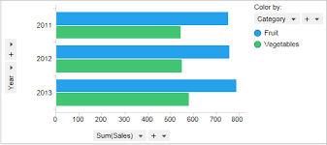
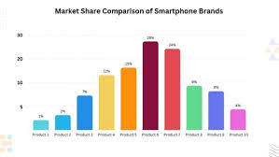
Session 3 : Charts
Type of Charts :
1- 📊 Column or bar Chart
Best for: Comparing values between categories
Example:

Slide 7
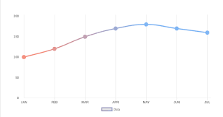
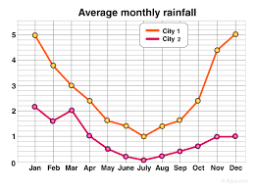
Session 3 : Charts
Type of Charts :
2- Line Chart
Best for: Showing trends over time
Example:

Slide 8
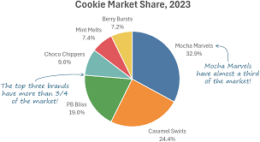
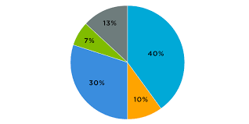
Session 3 : Charts
Type of Charts :
3- Pie Chart
Best for: Showing percentages or contribution
Example:

Slide 9
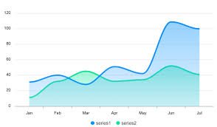
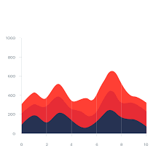
Session 3 : Charts
Type of Charts :
4- Area Chart
Best for: Showing trends + volume over time
Example:

Slide 10
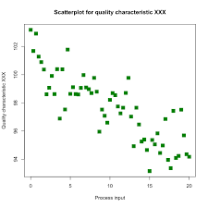
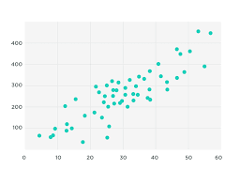
Session 3 : Charts
Type of Charts :
5- Scatter Chart
Best for: Showing relationship between two numeric variables
Example:

Slide 11
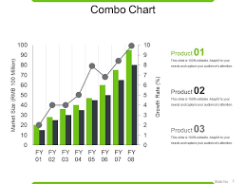
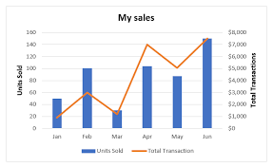
Session 3 : Charts
Type of Charts :
6- 📌 Combo Chart
Best for: Comparing two different measures
Example:

Slide 12
Session 3 : Exercise
Exercise 6 : Vehicle Sales Performance Analysis
You are a Junior Data Analyst in a Vehicle company.
The company sells different Types of Vehicle across Different countries .
Load Dataset (Ex6) File !
Management wants a simple performance report to understand:
What is Total Selling Price
Give me Trend for Selling Price !
Who are the Best Seller ?
Please give me Small and simple Report with good conditional Format to represent the above KPIs in Tables or Text format (We Need to See some Charts ) !!!!

Slide 13
Thanks
Do you have any questions?

